Slide 1



‘Current Research Information Systems (CRIS): What are they and what do they do?’
James Toon
Research Information Systems Manager, University of Edinburgh
17th March 2015
@jamestoon

Slide 2
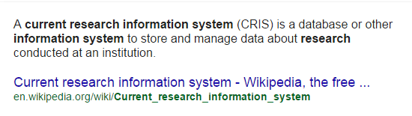
What is a CRIS?
This is a reasonable ‘starting point’…
…But far too simplistic really.

Slide 3
1. Characterisation of a CRIS system
Picture of the current research capability and current research activity being undertaken by an institution
Like to think of it as an academic CV representing the whole institution
Provides platform for integrated research information management
Provides services for both ‘top-down’ and ‘bottom up’ requirements of researchers and administrators
People
Organisation/Subject

Slide 4
2. CRIS Scope
Very broad in coverage, servicing institutional research needs;
Pre-award (funding discovery, applications management)
Post-award (funding awarded, projects, management process)
People (Academic attributes, profiles, CV’s, supervisions)
Research outcomes (i.e. publications, press, patents, impact, research data)
Professional activities and accolades (i.e. invited presentations, peer/editorial review, prizes or awards)
Student (i.e. workflows for thesis deposit)
Research assessment and compliance
Management information (KPI, metrics, bibliometrics)

Slide 5

3. Integrated architecture
Allows integration with corporate systems (such as HR and Finance) for data that is managed as the ‘golden copy’ elsewhere in the institution
Research Administrators
Data in
HR
Finance
Pre-award
Student Systems
IP/Licensing systems
Press Office
Data out
Portals/Discovery services
Institutional repositories (inc. Data)
Content Management Systems
Web Services
CV’s
Research assessment
CRIS Workflows
Happy Users

Slide 6
…Edinburgh Approach
Content synchronised via HR, Finance systems on nightly basis
Corporate
Systems
Intermediate data (built in-house)
CRIS – the admin interface
Managed
via
Edinburgh Research
Explorer
Published via
Web service layer

Slide 7
…The repository question
Can a CRIS system connect to an external institutional repository?
Yes
Known connectors in place for most repositories (Dspace, ePrints, Fedora etc.)
Carries some business and technical risks
Repository functionality and services provided by most CRIS suppliers
CRIS web portals for public access
Additional ‘repository functions’ increasingly provided (DOI minting, Preservation, OAI-PMH)
Whether you should is entirely down to you…

Slide 8
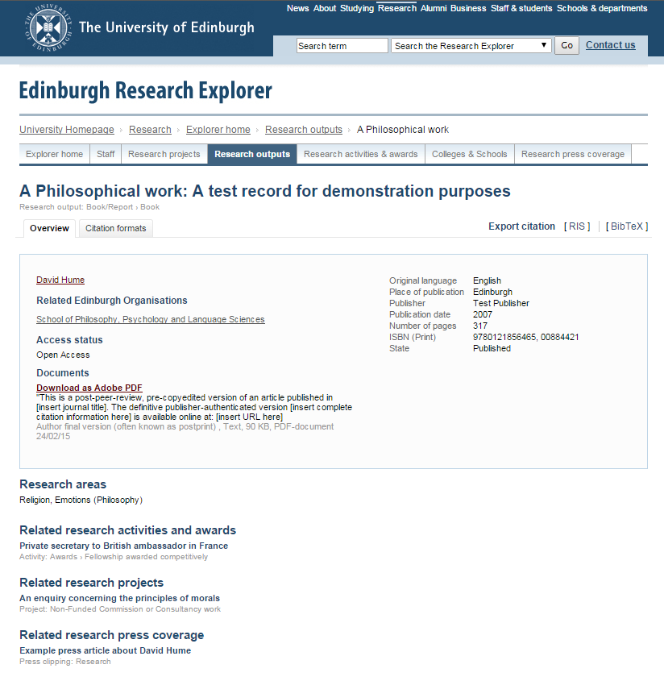
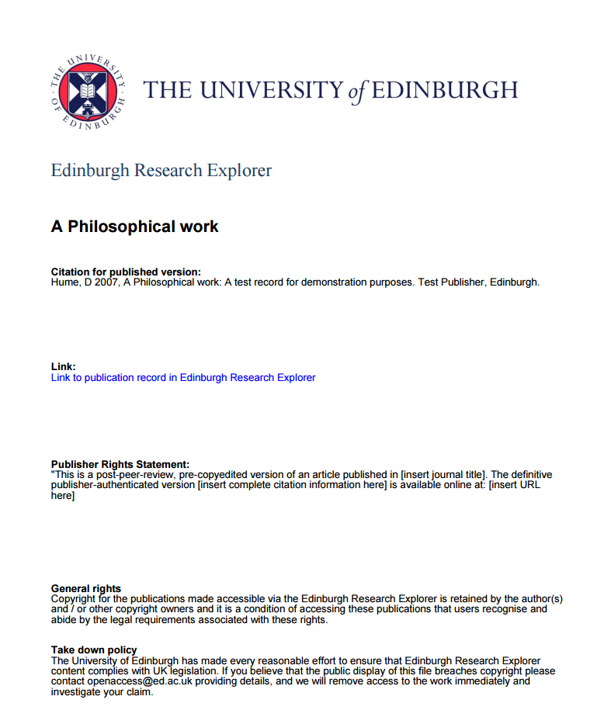
Publications with full text (open access) content available via Edinburgh Research Explorer, together with information on rights as required.
Coversheet to provide additional information and rights detail
Able to link related funding and other content types.

Slide 9
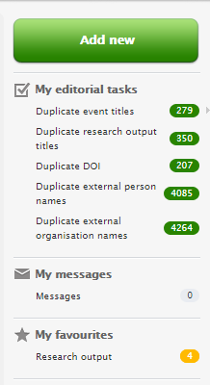
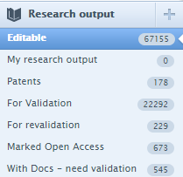
4. Integrated services and workflows
Content can be managed using complex workflows designed to meet specific administrative and academic purposes (such as maintaining publication record/REF/open access etc.)
Funding discovery
Applications management
Post award management
Research outcomes management
Research assessment
Public access via web portal
Web services/API

Slide 10

…User communities – Edinburgh Experience
CRIS requires close collaboration between departments, which has the benefit of breaking down functional silos. There are challenges however with how to approach stakeholder management.
Approaches are very different across different subjects
Research Information Management as a profession
University data governance – managing the institutional data model
Coordinating messages across departmental teams to academic staff
Introduction of new content types
Managing expectations of academic staff
By Kim Traynor (Own work) [CC BY-SA 3.0 (http://creativecommons.org/licenses/by-sa/3.0)], via Wikimedia Commons

Slide 11
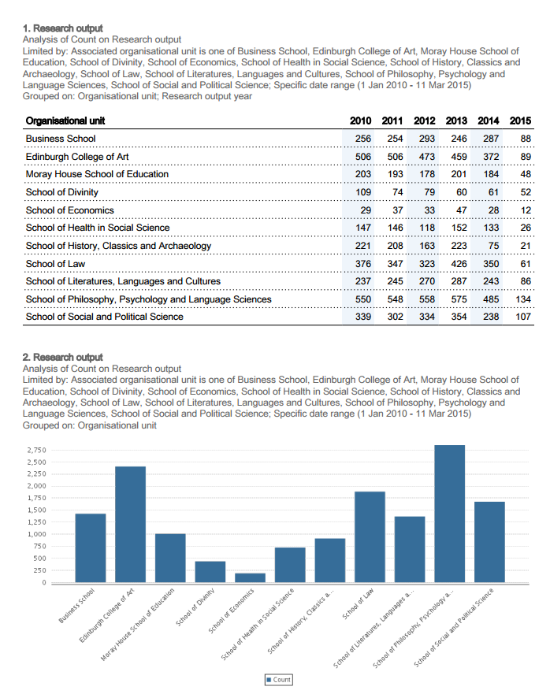
5. Analysis of data
Content can be systematically analysed and is reportable
What proportion of my School published open access in accordance with policy x
Show me the total editorial/peer review activities undertaken by research staff in high impact journals for my unit of assessment
We wish to develop our collaborations with University X, who are the best people to help us make initial contact, and which subjects should we focus on
What press coverage across my School might provide evidence of impact

Slide 12
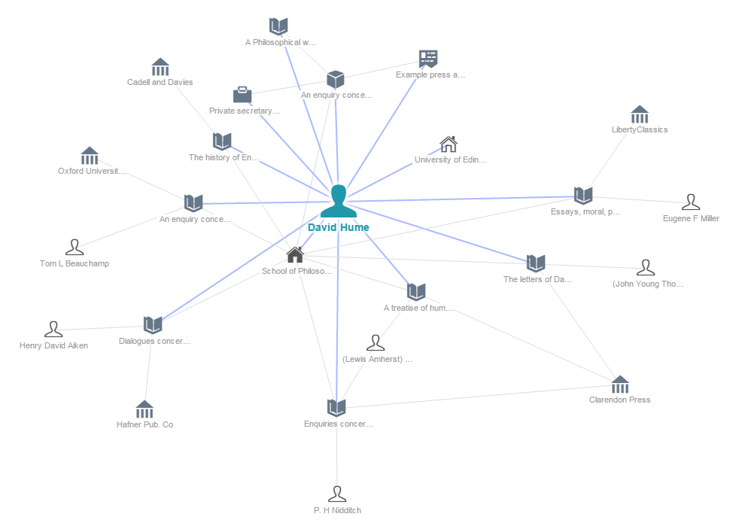
6. Data Connections
Content can be easily related to other content
Publication è Activity è Paper è Impact
Funding è Publications
Project è Funding_{a} thru Funding_{n} with associated outcomes
Equipment è Research Data è Publication
Explore co-author networks

Slide 13

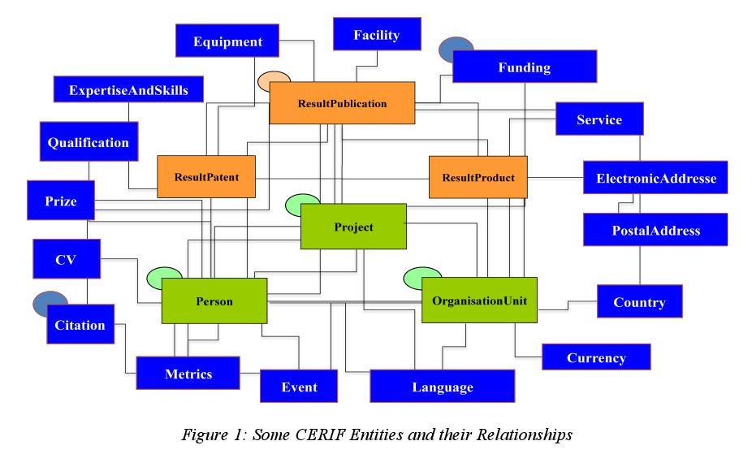



7. Standardisation and data quality
Content is consistent, well formed and subject to quality controls
Content policies ie. Syntax for describing external organisations
Taxonomies for content type (i.e. activities, impact evidence)
Use of identifiers (i.e ORCID)
Use of common data models (i.e. CERIF, VIVO) allow for benchmarking and data transfer

Slide 14
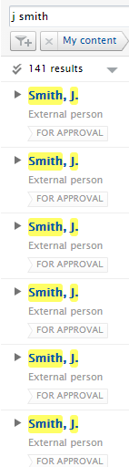
…Data quality – Edinburgh Experience
Keeping on top of maintenance chores a BIG job, made more complex by having a CRIS.
For example, on top of dealing with management of outcomes data we have to curate and disambiguate;
50398 external organisations
144976 external persons
10320 journals
3768 publishers

Slide 15

8. Content is available for reuse
Content is accessible for multiple institutional purposes, reducing duplication of entry
Paper
Person
Aim to be ‘one stop shop’ for researchers and research managers
Use in CV’s for promotion, review, proposal
Use in press releases and news items (deep linking)
Re-use in promoting activity and developing impact
Re-use for web applications and school/college websites
Use for research strategy
Event
Activity
impact

Slide 16
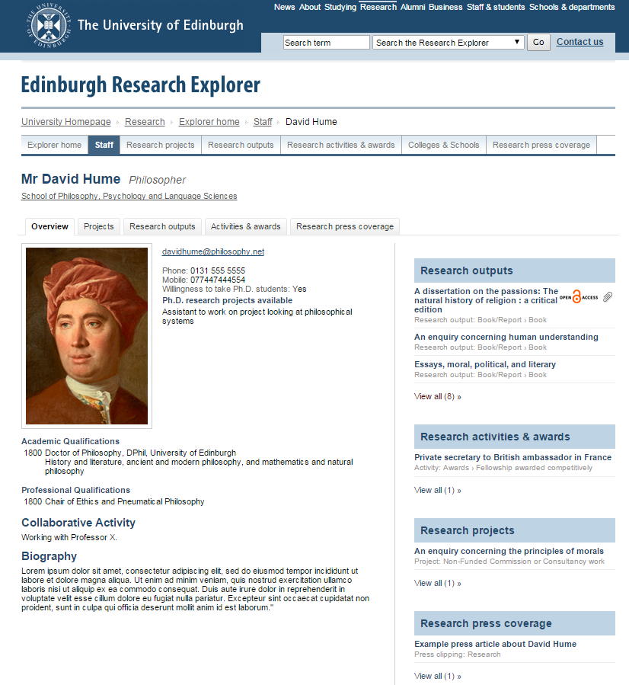
9. Content is marketable
Content is capable of selling the institutional research capability
Promotion of University research capability via dedicated portals
Aggregate view of research for public, press, potential staff/students
Content can be delivered for specific community purposes
Content accessible via discovery services or via web API/OAI-PMH
Content added to the CRIS is available publicly via the Edinburgh Research Explorer.

Slide 17





10. Content for external usage
Content is transportable – can be used to submit to external sources in an interoperable format
Research assessment (REF)
Compliance reporting (i.e. RCUK)
Statistical Reporting (HESA)
Collaboration between institutions
As part of national/international aggregation systems

Slide 18
Thank You for listening. Any Questions?
Please feel free to email me at anytime on james.toon@ed.ac.uk if you need any further information

